Slide 1
WHAT IT TAKES TO WIN

Slide 2
The data
Data Scraped from Basketball Reference. Taken as player box scores then combined.
Olympic Games 2000 – 2016 containing 198 games
Fiba World Cup 2010,2014 and 2019 containing 248 games
total of 448 games from 42 individual teams
minimum games played 5
maximum played 66
15 initial statistics provided and 11 more created from existing data

Slide 3
Method
Assess the statistical similarity teams that have a top 4 finish
Build multiple models to predict points scored based on statistics provided and compare
Build multiple model to predict the outcome of the game based on statistics provided and compare
Analyse the results and what statistics are valuable in predicting performance.

Slide 4
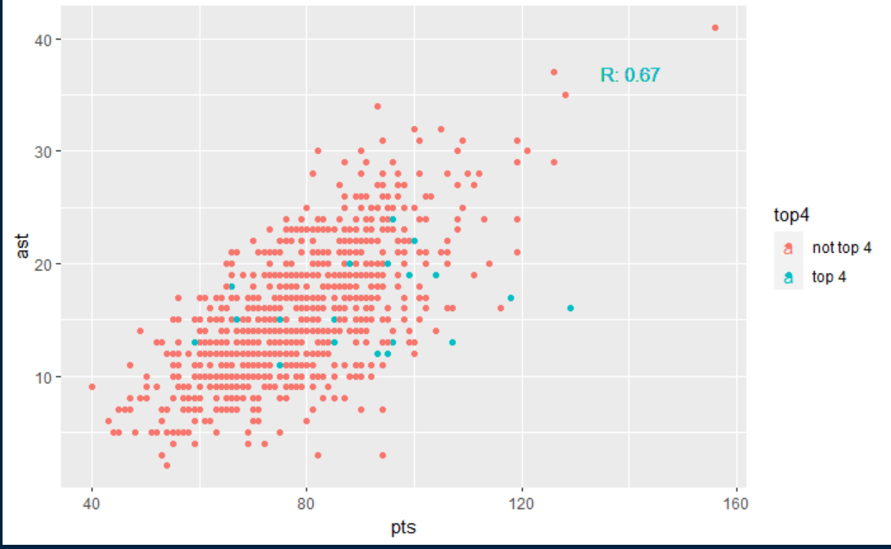
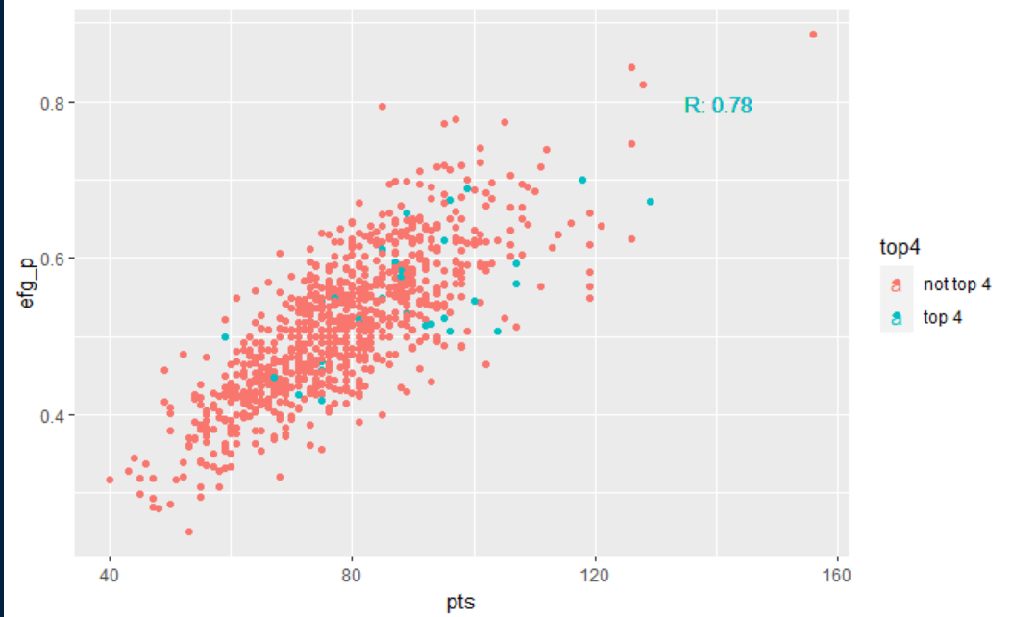
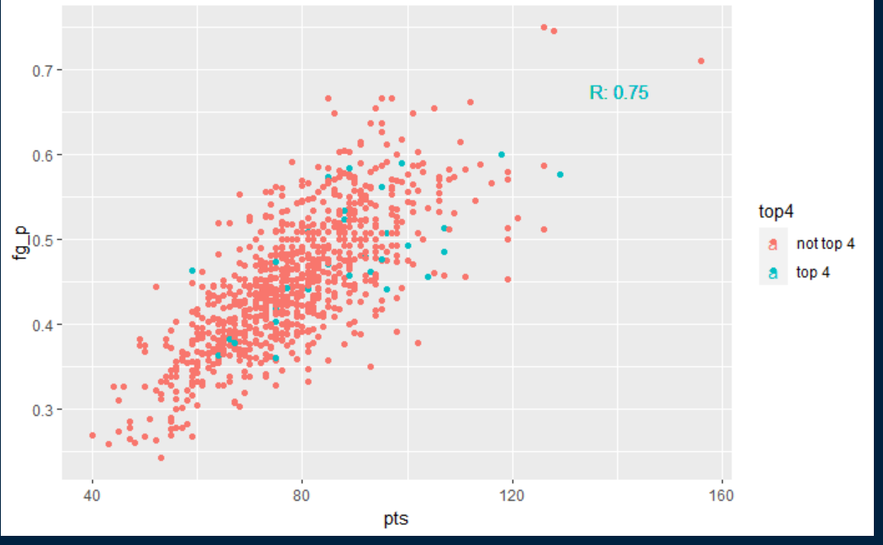
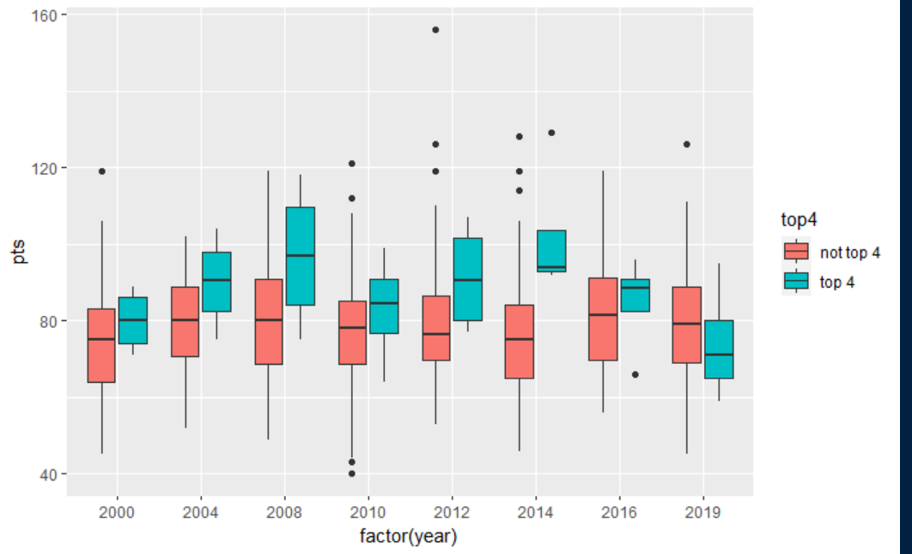
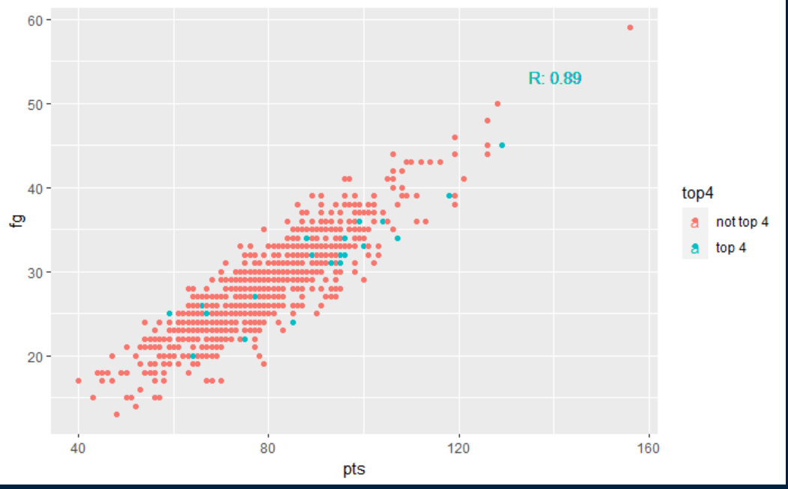
Commonality of top 4 finishes
Top 4 Finishes
Country | World Cups | Olympics | Total
United States | 2 | 5 | 7
Lithuania | 2 | 3 | 5
Spain | 1 | 3 | 4
France | 2 | 1 | 3
Serbia | 2 | 1 | 3
Argentina | 1 | 2 | 3
Australia | 1 | 2 | 3
Turkey | 1 | 0 | 1
Greece | 0 | 1 | 1
Puerto Rico | 0 | 1 | 1
Russia | 0 | 1 | 1
Looking for patterns in the number of points scored and the relationship with other variables
Points Distribution of top 4 vs the rest
Notes:
The four plots on the right show a high correlation with points but no distinct similarity with teams that finish in the top 4. I see this as evidence that there is no clear answer and instead it is important to used some models to better understand the data. I will either overlay the plots in successive slide or I have build a Shiny that I could pull up and use.

Slide 5
Predicting Points - EDA
Using the shiny https://sport-data-insights.shinyapps.io/Basketball_Exploratory_Data_Analysis/
show the lower relationship with pts and ORB , BLK, ft_p
and the higher correlation with ts_p, efg_p

Slide 6
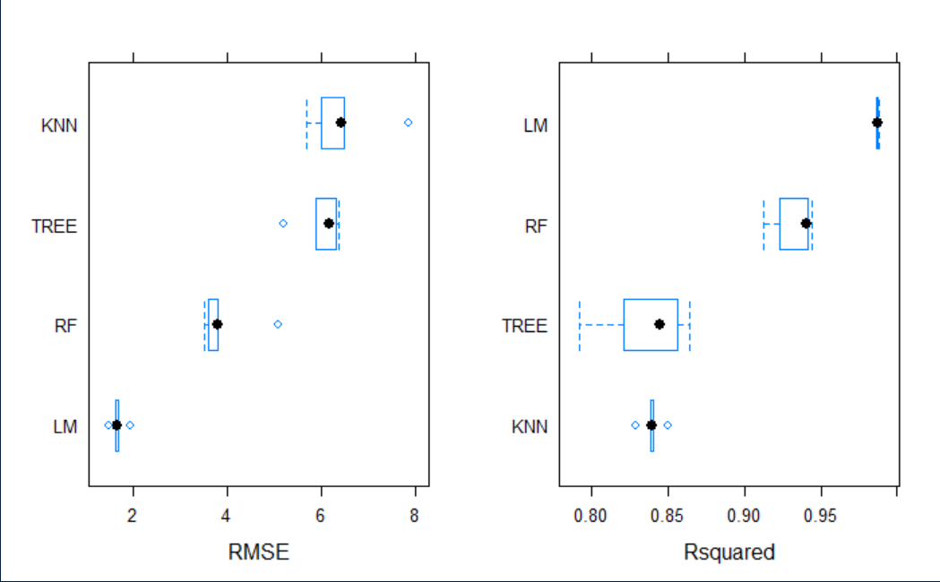
Predicting points - Results
Explain that I put a smaller number of features through a KNN, Decision tree, Random forest and Multiple linear regression model
explain the RMSE and Rsqaured values
The final results being the linear model can predict a teams points to ~1.9 each time.

Slide 7
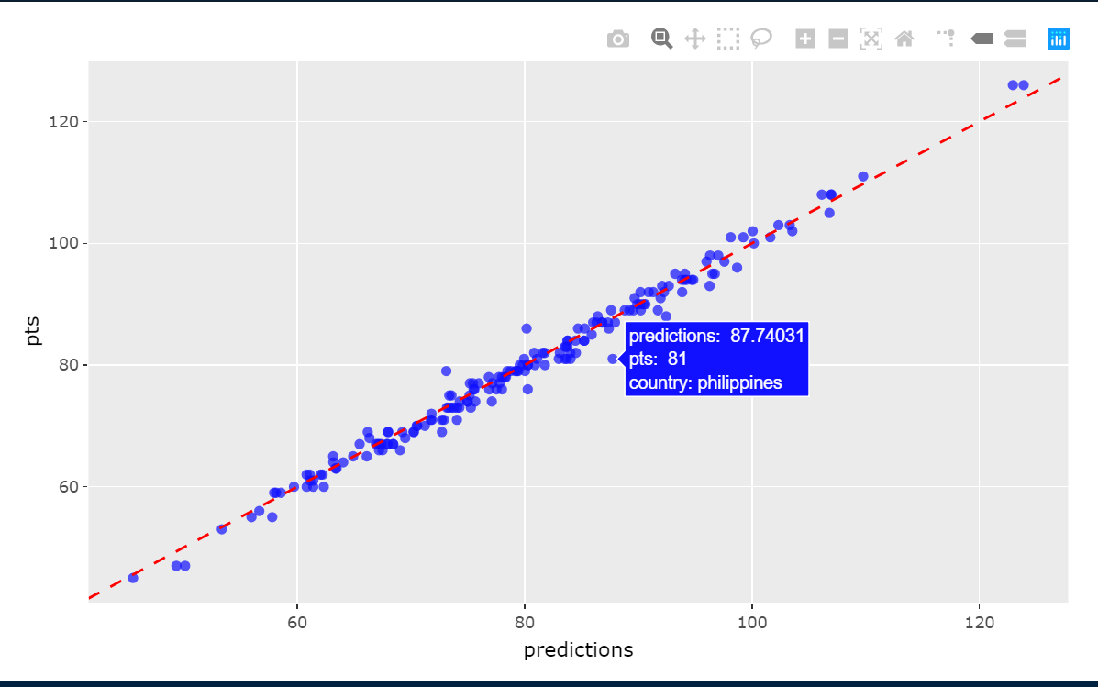
LM model results on training
The red line represents the perfect linear model, the further from the line the more incorrect the prediction is.

Slide 8
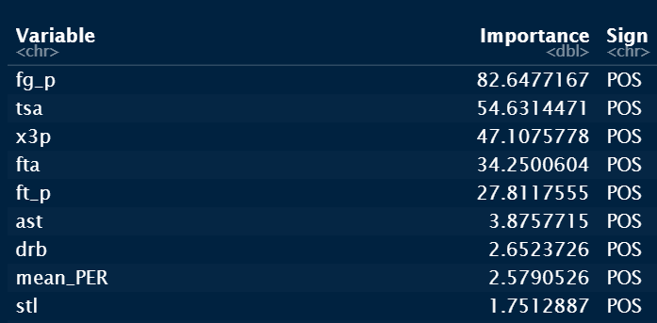
Variable importance Points
These are the values the linear regression model regards as important

Slide 9
Predicting Wins - EDA
Use the shiny to point out a few key similarities and differences. https://sport-data-insights.shinyapps.io/Basketball_Exploratory_Data_Analysis/
Winning teams have a higher number of made FT, FTA, Total rebound, ast, stl, blk,
similar ft_p, tsa, fga,

Slide 10
Predicting results - results
using a the classification algorithms decision tree, random forest and logistic regression the win loss was predicted
the best performing model was logistic regression
Predicting 120 losses, 121 Wins correctly
predicted 13 Losses as wins and 12 Wins as Losses
 | L | W
L | 120 | 12
W | 13 | 121

Slide 11
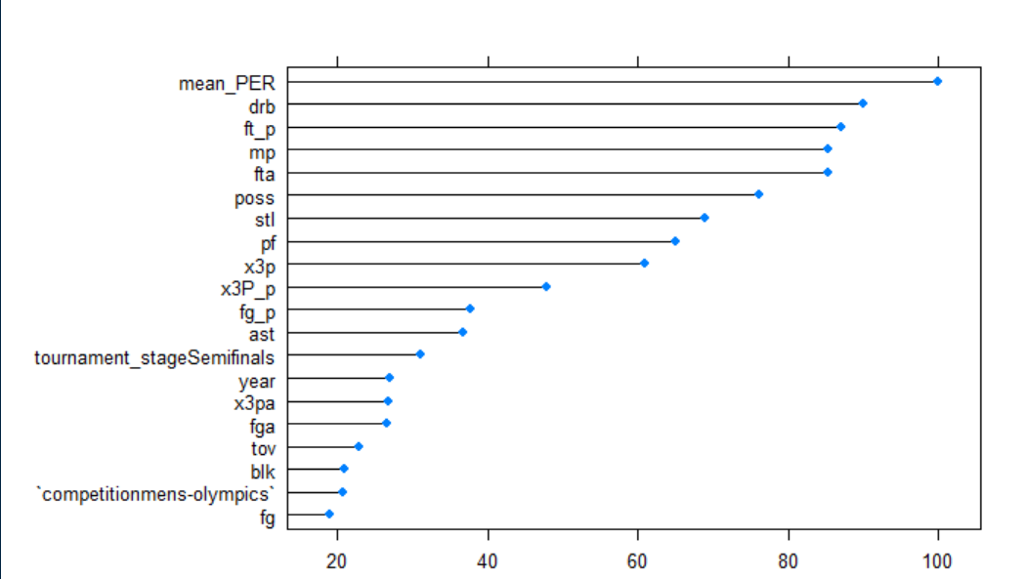
Variable importance Wins
These are the values the logistic regression model regards as important

Slide 12
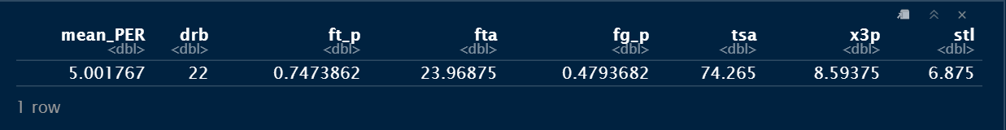
Areas to assess to predict success
Based on the variable importance from the models the stats that are the best predictors of points and W/L is PER, DRB, Ft-P, FTA, stl, fg_p, tsa, 3p
The average rating in those categories from teams that finished in the top 4 is:
I would be using this as a bench mark to evaluate the likelihood of a team making the top 4.

Slide 13
Future work
Analysis of the domestic leagues the medal winning players compete in
Translation of domestic league statistics to international game
league coefficients
Does Junior international success translate to senior success.

Slide 14
Shiny URL
https://sport-data-insights.shinyapps.io/Basketball_Exploratory_Data_Analysis/
Github repository
https://github.com/RobertRiddell/Olympic-Basketball

